Slide 1
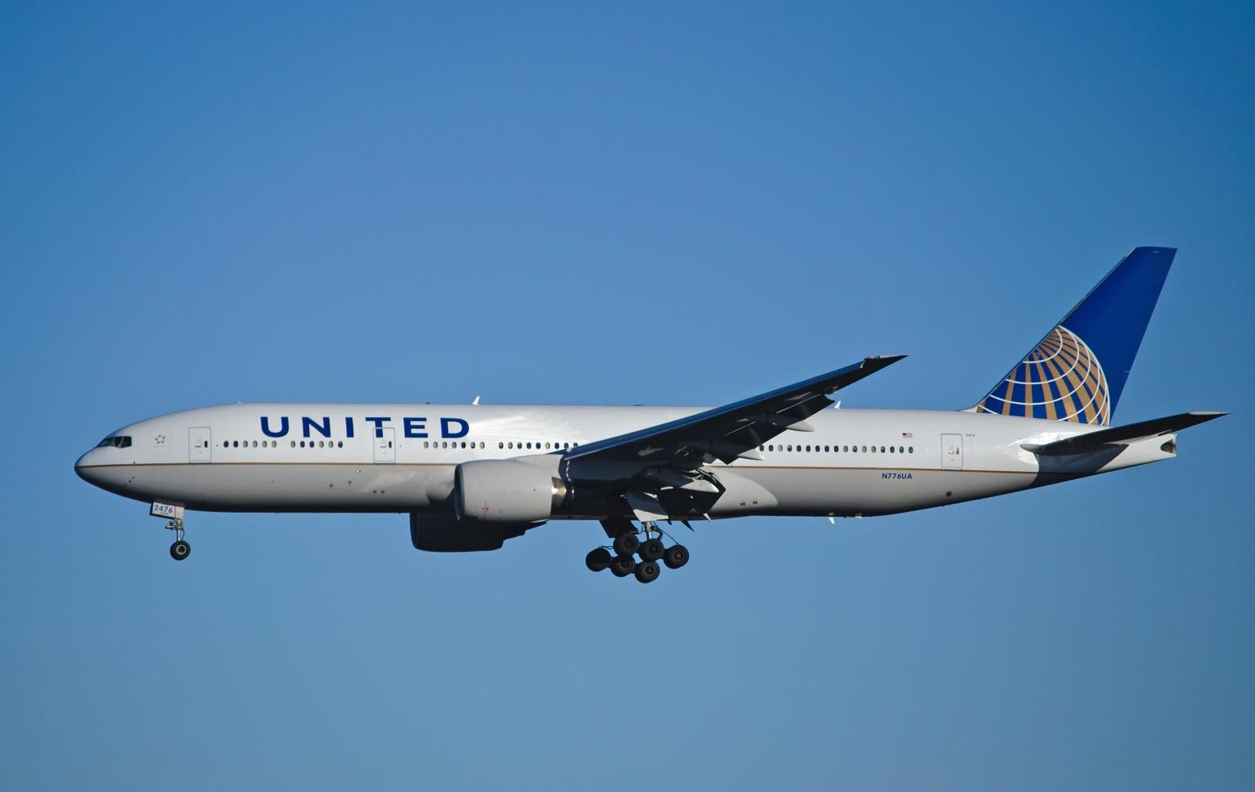
SKYHACK
Unmik Gyawali 2K20/IT/154

Slide 2
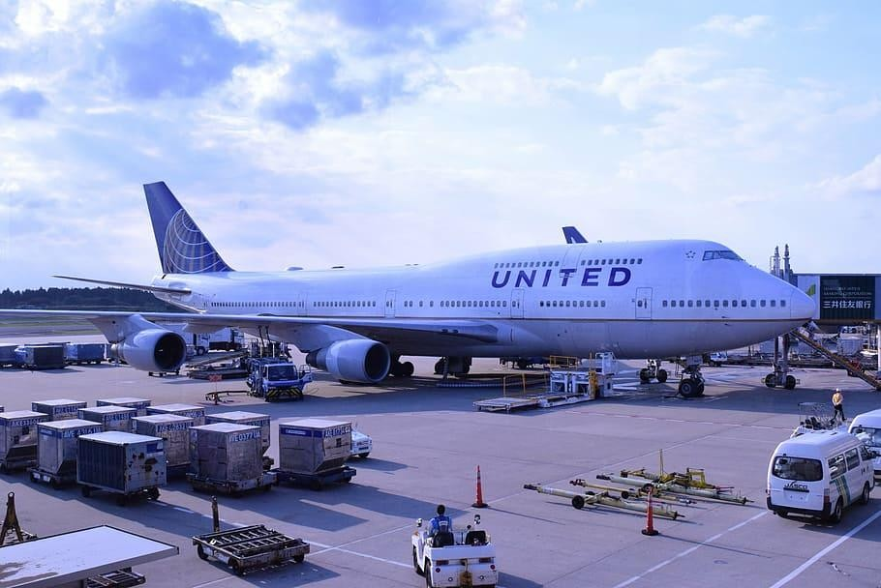
Applied Linear Regression to analyse the
Deliverables
relationship between the the pre ordered meals and passenger satisfaction
Categorised the passenger age, haul type and onboard media provider on the basis of satisfaction scores to draw meaningful conclusions
Calculated the top 10 most consumed entrees on board the first class cabin
Python Libraries Used
Pandas: Data cleaning, Joining Operations
Numpy: Mathematical Computations
Sickit-learn: Linear Regression Model
Matplotlib: Data Visualisation

Slide 3
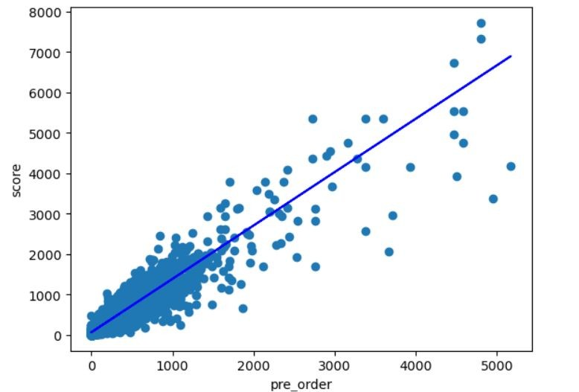
The slope coefficient of 1.32044757 indicates that for each unit increase in the number of pre-ordered meals, the user food and beverage satisfaction score is expected to increase by approximately 1.32 points. This suggests a positive relationship between pre-ordered meals and user satisfaction. Based on the findings, the following are some of the steps we can take to potentially increase the user satisfaction rate:
Promote pre ordering
Provide a diverse menu selection for pre ordered meal
Consider competitive and reasonable pricing for pre ordered meals
The coefficient of determination (R squared) indicates that our regression model is a good fit for the given dataset.

Slide 4
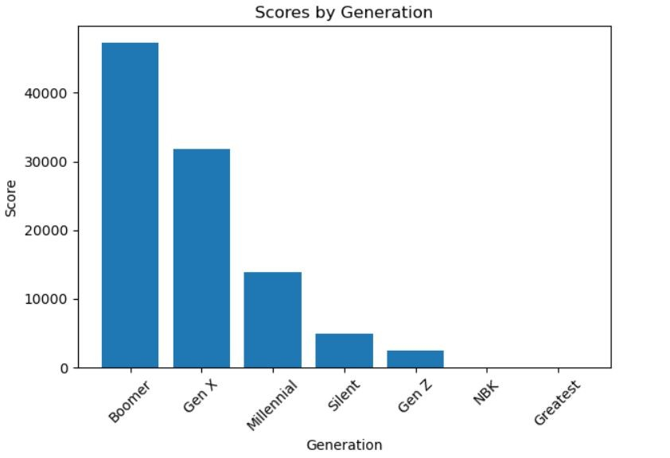
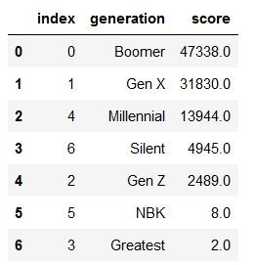
Categorizing the satisfaction scores according to different age generations, the following inferences can be made:
There is satisfaction on the food and beverages provided among the older generation whereas the relatively lower satisfaction score for the younger generation indicates that there is scope for improvement.
The data highlights that different generations have varying preferences. Tailoring the food and beverage provided according to different age groups could lead to a higher satisfaction rate.
Furthermore, United Airlines could come up with promotions specifically for the generations with lower satisfaction scores to improve their experience.

Slide 5
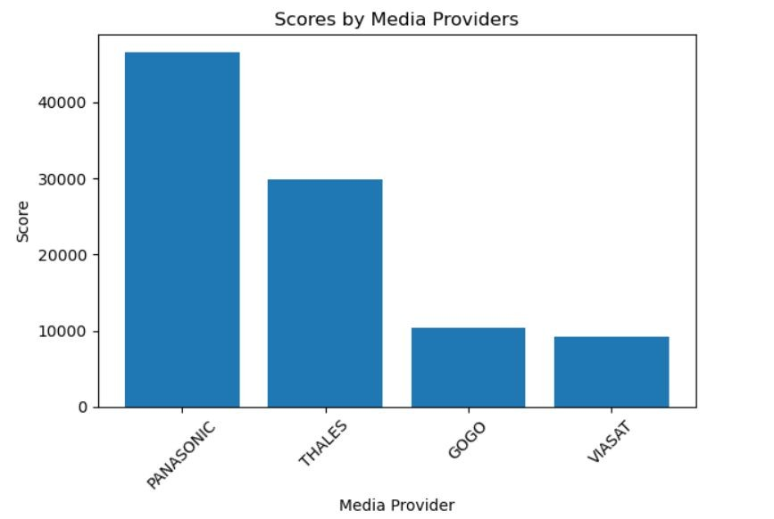
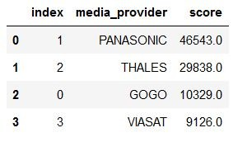
A positive inflight media experience could indirectly influence a passengers satisfaction with the food and beverages provided. The following inferences can be made from the flights inflight media provider data:
High satisfaction scores on flights having PANASONIC as the media provider indicates a positive perception of the inflight entertainment and media services provided by PANASONIC.
The lower satisfaction on flights with GOGO and VIASAT indicates that there is room for improvement.
Furthermore, United Airlines could consider forming strategic partnerships with providers that consistently receive higher satisfaction scores.

Slide 6
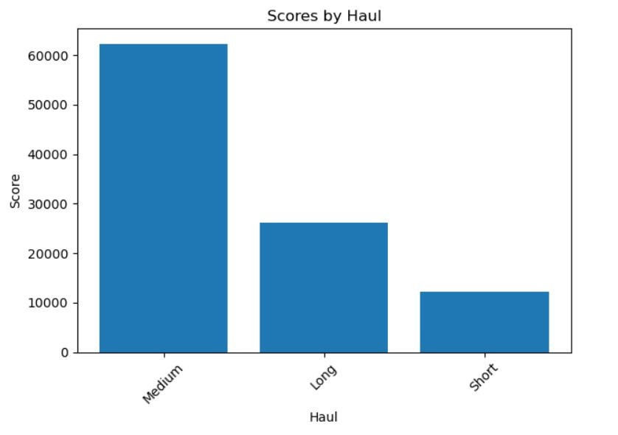
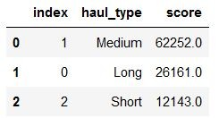
The following inferences can be made from the flights haul type data:
Passengers on medium haul flights have experienced the highest amount of satisfaction with the food and beverages .
The relatively lower score for long haul flights indicates that it is challenging to maintain passenger satisfaction over extended flight durations.
Based on the haul data, United Airlines should consider tailoring its food and beverage options as per the haul type. Longer flights may need more diverse meal options.

Slide 7
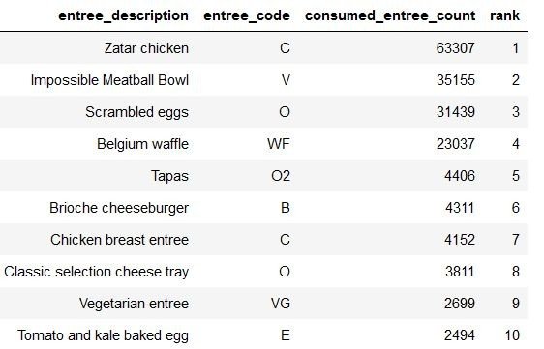
We can make the following inferences based on the top 10 most consumed entrees of the first class deck of United Airlines flights during the given time frame :
The variety of entrees suggest that passengers have diverse meal preferences and it is essential to meet this need.
Entrees like “Scrambled eggs” and “Belgium waffles” suggest that breakfast and brunch options as preferred by passengers.
Extra inflight inventory of the most popular entrees is important. The least popular entree inventory could be cut down to save space.

Slide 8
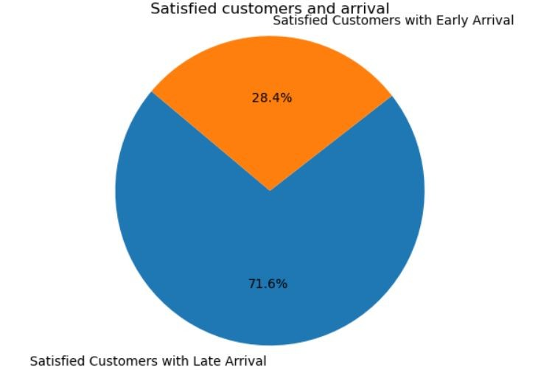
Pre-analysis, I hypothesized that the arrival time may have a significant impact on the food and beverage satisfaction rate because passengers frustration due to a delayed arrival might negatively influence their review.
However, on analysing the given dataset, it was observed that 71.63% of satisfied customers had late arrival, indicating that arrival time may not be a major driver of food and beverage satisfaction

Slide 9
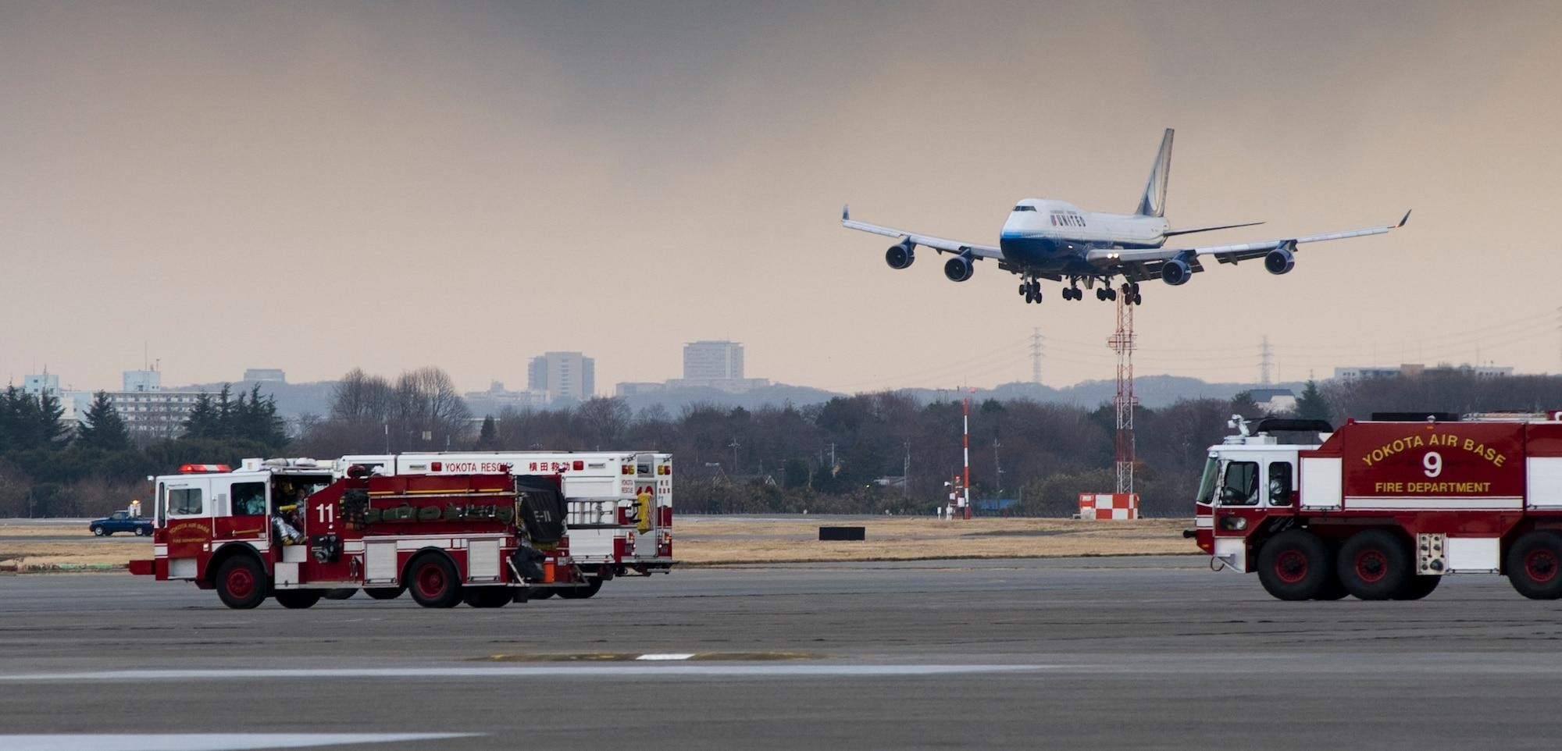
A linear relationship exists between pre-ordered meals and customer F&B satisfaction rate.
Younger generations have a lower satisfaction score, indicating room for improvement.
Flights with Panasonic as the media provider have a higher rate of F&B satisfaction.
There is a need for diverse meal options on longer flights.
Brunch options are mostly preferred.
Arrival times and delays do not have direct impact on the satisfaction rate.
Key Takeaways

